Slide 1
Modeling for Verification
刘骞-51184501130 2018.11.2

Slide 2
contents
Introduction
Major Considerations in System Modeling
Simple Modeling Language（SML）
Examples of SML
From SML Programs to Kripke Structures
Summary

Slide 3
Introduction

Slide 4
contents
Introduction
Major Considerations in System Modeling
Simple Modeling Language（SML）
Examples of SML
From SML Programs to Kripke Structures
Summary

Slide 5
What should we consider ?
type of system
discrete(-time) systems continuous(-time) systems concurrent processes ……………
Type of Property
Real-time properties（timed automaton） Boolean properties（propositional temporal logic）
Modeling the Environment
Level of Abstraction
Clarity and Modularity
Form of Composition
Computational Engines
Practical Ease of Modeling and Expressiveness

Slide 6
What should we consider ?
type of system
discrete(-time) systems continuous(-time) systems
concurrent processes ……………
Type of Property
Real-time properties（timed automaton）
Boolean properties（propositional temporal logic）
Modeling the Environment
Level of Abstraction
Clarity and Modularity
Form of Composition
Computational Engines
Practical Ease of Modeling and Expressiveness

Slide 7
What should we consider ?
type of system
discrete(-time) systems continuous(-time) systems
concurrent processes ……………
Type of Property
Real-time properties（timed automaton）
Boolean properties（propositional temporal logic）
Modeling the Environment
Level of Abstraction
Clarity and Modularity
Form of Composition
Computational Engines
Practical Ease of Modeling and Expressiveness

Slide 8
Modeling Languages
Hardware description languages (HDLs).
General-purpose modeling languages(UML)
Architecture Description Languages (ADLs)
Simulation-oriented languages and tools
Reactive programming languages
Verification languages

Slide 9
Challenges in Modeling

Slide 10
contents
Introduction
Major Considerations in System Modeling
Simple Modeling Language（SML）
Examples of SML
From SML Programs to Kripke Structures
Summary

Slide 11
Simple modeling language (SML)

Slide 12
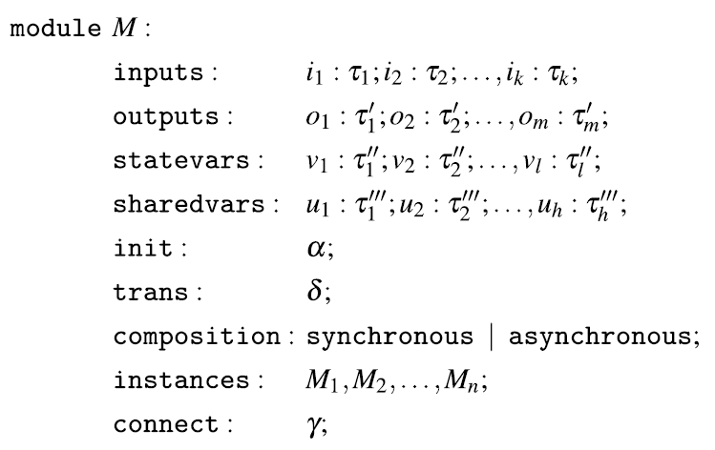
Syntax
A primitive module does not have the composition, sharedvars, instances, and connect sections .

Slide 13
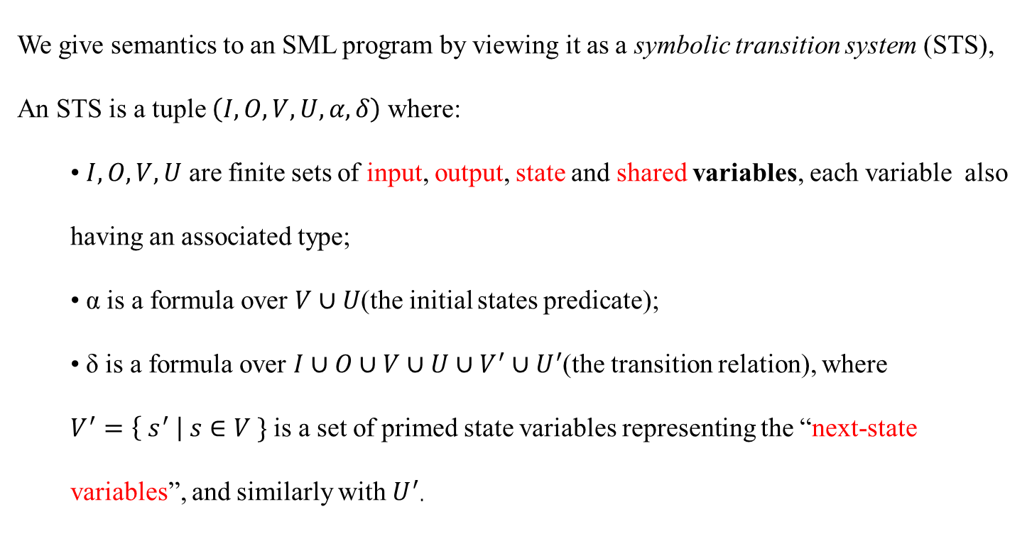
Semantics
We give semantics to an SML program by viewing it as a symbolic transition system (STS),
An STS is a tuple $\left(I,O,V,U,α,δ\right)$where:
• $I,O,V,U$ are finite sets of input, output, state and shared variables, each variable also having an associated type;
• α is a formula over $V∪U$(the initial states predicate);
• δ is a formula over $I∪O∪V∪U∪V^{′}∪U^{′}$(the transition relation), where
$V^{′}=\left\{ s^{′} \right| s∈V \}$ is a set of primed state variables representing the “next-state variables”, and similarly with $U^{′}$.

Slide 14

Semantics
If M is primitive, then
$STSM=(I,O,V,∅,α,δ)$
(the set of shared variables is empty).
If M is composite, then
$M=M_{1}∪M_{2}∪…∪M_{n}$,
and then
$STSsM=\left(Ii,Oi,Vi,∅i,αi,δi\right)$
for $i=1…..n$

Slide 15
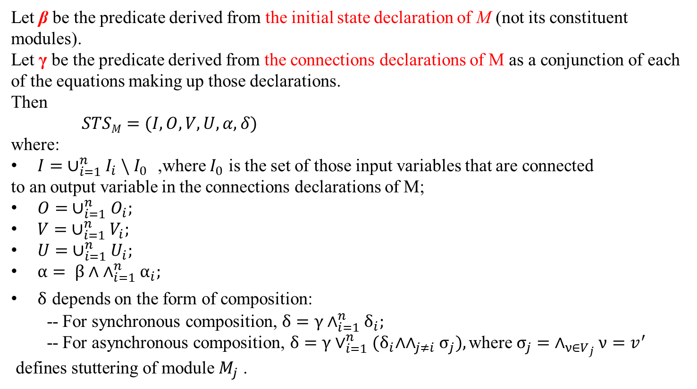
Semantics
Let β be the predicate derived from the initial state declaration of M (not its constituent modules).
Let γ be the predicate derived from the connections declarations of M as a conjunction of each of the equations making up those declarations.
Then
$STSM=(I,O,V,U,α,δ)$
where:
$I= ∪_{i=1}^{n}I_{i} \backslash I_{0}$ ,where $I_{0}$ is the set of those input variables that are connected
to an output variable in the connections declarations of M;
$O= ∪_{i=1}^{n}O_{i};$
$V= ∪_{i=1}^{n}V_{i};$
$U= ∪_{i=1}^{n}U_{i};$
$α= β∧ ∧_{i=1}^{n}α_{i};$
$δ$ depends on the form of composition:
-- For synchronous composition, $δ=γ∧_{i=1}^{n}δ_{i};$
-- For asynchronous composition, $δ=γ∨_{i=1}^{n}{(δ}_{i}∧∧_{j≠i}σ_{j}),\text{where}{ σ}_{j}=$ $∧_{ν∈V_{j}}ν=v^{′}$ $\text{defines} \text{stuttering} \text{of} \text{module}$ $M_{j}\text{ .}$

Slide 16
Modeling Concepts
Open and Closed Systems
Safety and Liveness
Fairness
Encapsulation
Moore and Mealy machines

Slide 17
contents
Introduction
Major Considerations in System Modeling
Simple Modeling Language（SML）
Examples of SML
From SML Programs to Kripke Structures
Summary

Slide 18
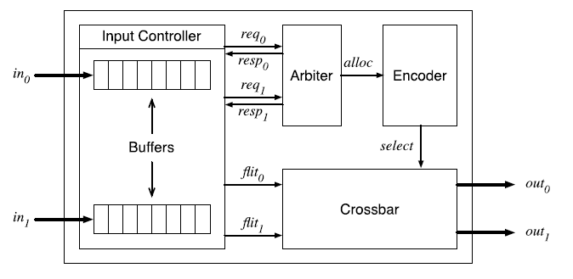
Synchronous Circuits
路由器的主要功能是将传入的数据包定向到正确的输出端口，每个数据包都由flit组成。
CMP路由器由四个主要模块组成，如图3所示。输入控制器缓冲传入控制器并与仲裁器交互。在接收到磁头flit时，输入控制器根据磁头flit中包含的目标地址请求对输出端口的访问。仲裁者以公平的方式授予对输出端口的访问权，使用一个简单的循环仲裁方案。其余模块为编码器和横杆。当仲裁者授予访问一个特定的输出端口,一个信号被发送到输入控制器释放缓冲区的掠过,与此同时,一个分配信号发送到编码器进而配置横掠过路由到适当的输出端口。
Chip-Multiprocessor (CMP) Router
Notes:
在输入控制器缓冲器传仲裁器使用简单的循环仲裁方案以公平的方式授予对输出端口的访问权。其余模块是编码器和交叉开关。当仲裁器授予对特定输出端口的访问权限时，入微片和与交互仲裁器。收到头部迁移后，输入控制器根据头部迁移中包含的目标地址请求访问输出端口。信号被发送到输入控制器以从缓冲器释放迁移，同时，分配信号被发送到编码器，编码器又配置 crossbar将flits路由到适当的输出端口。

Slide 19
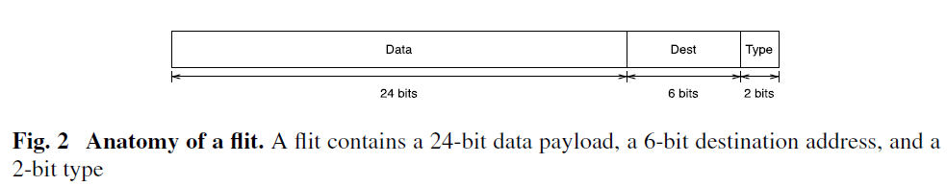
flit
There are three kinds of flits:
a head flit, which reserves an output channel
one or more body flits, which contain the data payload
a tail flit, which signals the end of the packet.

Slide 20
Simplifications
First, we assume that each flit that makes up the packet raises a request to the arbiter, not just the head flit; this eliminates some logic tracking the type of flit.
Second, we assume that the destination address, which indicates the output port to which a flit must be directed, is exactly two bits. Specifically, bits 2 and 3 of each flit encode the address, with 01 encoding output port 0 (bit 2 is 1 and bit 3 is 0), and 10 encoding output port 1. The destination address is directly copied to the request lines of the arbiter; the encoding 00 for a request line indicates the absence of a request.
Finally, we eliminate the Encoder module, directly using the alloc signals to route flits through the crossbar to the output ports of the router.
Notes:
首先，我们假设构成数据包的每个迁移都会向仲裁器发出请求，而不仅仅是头部迁移; 这消除了一些跟踪flit类型的逻辑。其次，我们假设目标地址，它指示一个必须指向flit的输出端口，正好是两位。具体来说，每个flit的第2位和第3位编码地址，01 编码输出端口0（第2位为1 ，第3位为0 ），10 编码输出端口1.目标地址直接复制到请求行仲裁者; 编码00对于请求行，表示没有请求。最后，我们消除了编码器模块，直接使用alloc 信号将flits通过交叉开关路由到路由器的输出端口。

Slide 21
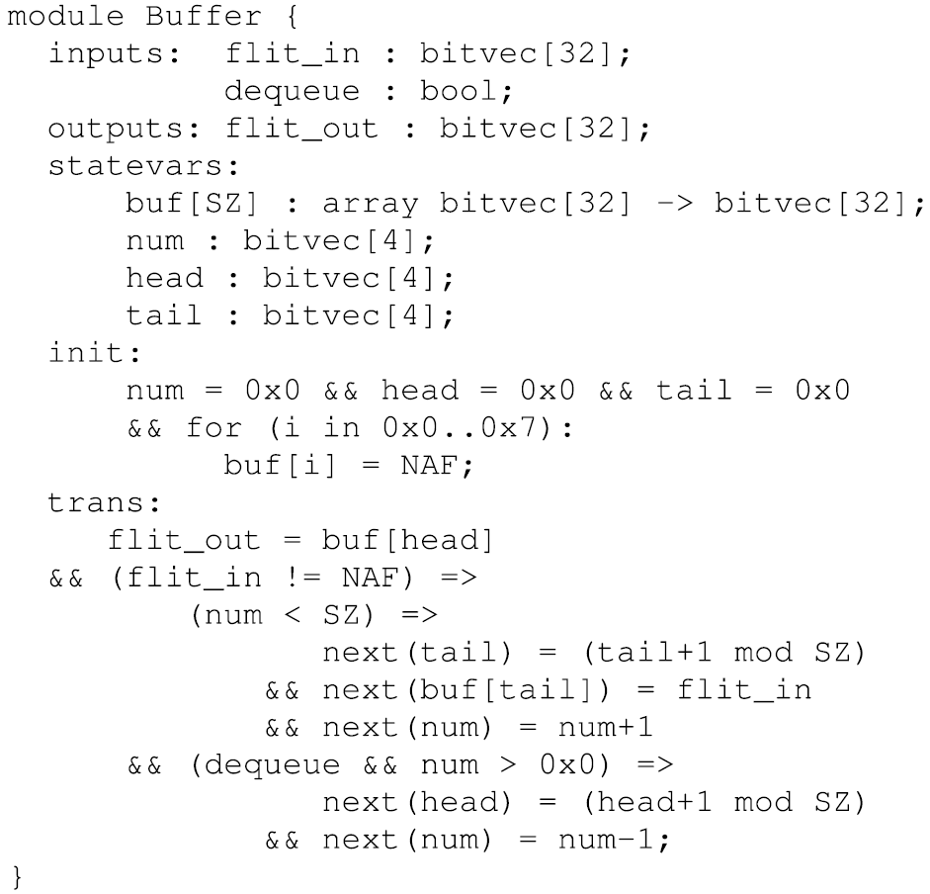
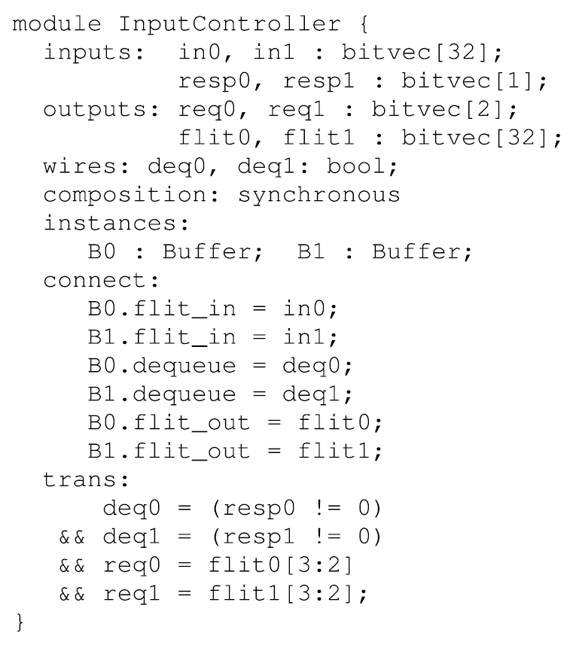
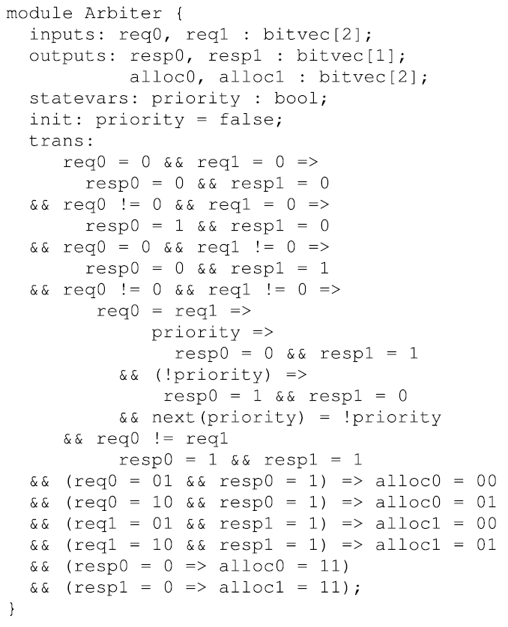
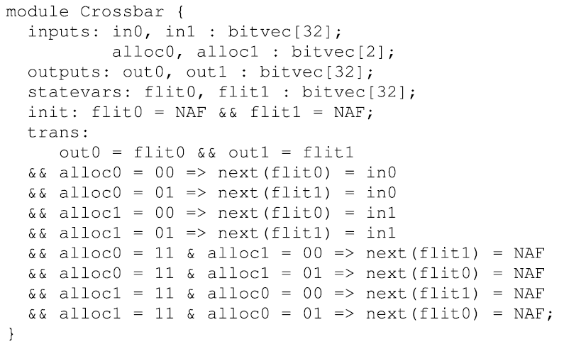
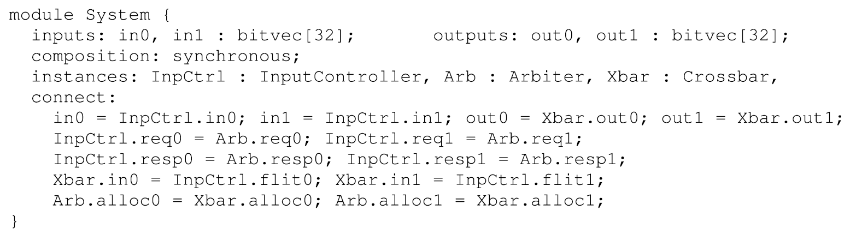

Slide 22
contents
Introduction
Major Considerations in System Modeling
Simple Modeling Language（SML）
Examples of SML
From SML Programs to Kripke Structures
Summary

Slide 23
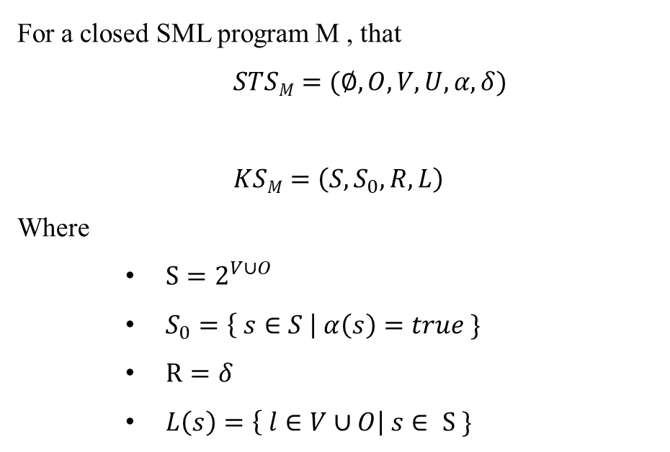
From SML Programs to Kripke Structures
For a closed SML program M , that
$STSM=(∅,O,V,U,α,δ)$
$KSM=\left(S,S_{0},R,L\right)$
Where
$S=2^{V∪O}$
$S_{0}=\left\{ s∈S \right| α\left(s\right)=true \}$
$R=δ$
$L\left(s\right)=\left\{ l∈V∪O\right| s∈ S \}$

Slide 25
contents
Introduction
Major Considerations in System Modeling
Simple Modeling Language（SML）
Examples of SML
From SML Programs to Kripke Structures
Summary

Slide 26
Simple modeling language (SML)
我们使用符号迁移系统 [ STS symbolic transition system ]来描述SML程序的语义。
STS =（ I，O，V，U，α，δ ）
I，O，V，U是输入，输出，状态和共享变量的有限集合，每个变量也具有相关类型;
α是初始状态： V∪U 。
δ是迁移关系： I ∪ O ∪ V ∪ U ∪ V' ∪ U' ，其中 V' = { s' | s ∈ V } 表示“下一个状态”的集合，U'类似于V'。
私有模块：共享变量的集合为∅。所以 M =（ I，O，V， ∅ ，α，δ ）。
复合模块：假设M是由模块M₁，M₂，...，M_{n} 组成，对应的STSs形式为（ I_{i} ， O_{i} ， V_{i} ， U_{i}，α_{i}，δ_{i} ）其中i = 1, . . . , n. 设β是从M的初始状态声明（不是其组成模块）导出的谓词。令γ为从M的连接声明派生的谓词，作为构成这些声明的每个等式的连接。然后，M的STS是（I，O，V，U，α，δ），其中

